Slide 1
X-section VA-VB
See Cross section locations.kmz & Cross section labels.kmz for location in Google Earth

Slide 2
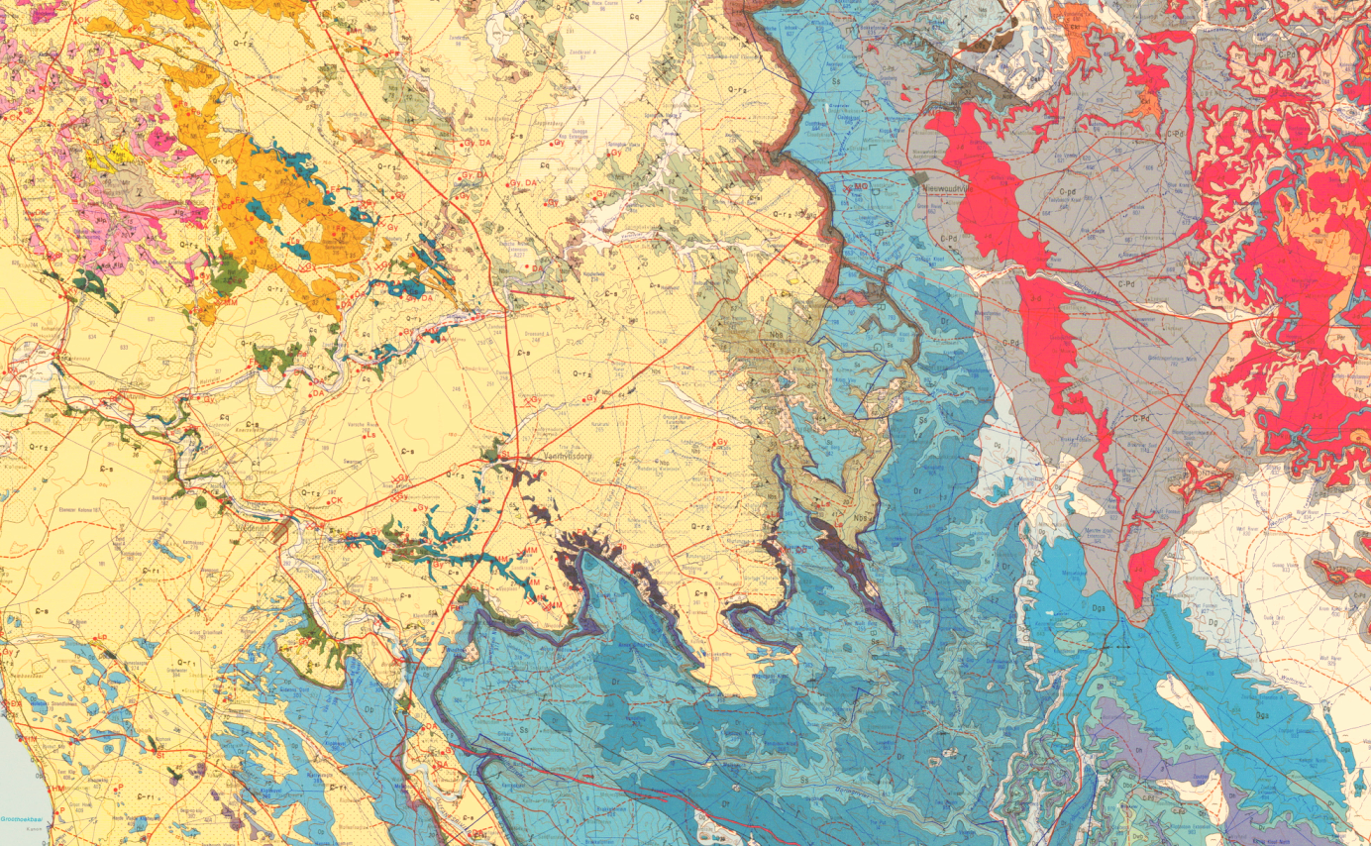
VB
Calvinia 1: 250 000 Geology
VA

Slide 3
Sketch geologic cross-section VA-VB through the Vanrhynsdorp area
See Stratigraphic column for 3118 Calvinia for explanation of Formation codes
masl
masl
1000
Dr
Ss
1000
C-Pd
Dol
Gifberg
Ss
Ss
Ow
500
Op
500
Ow
Op
Undifferentiated Vanrhynsdorp Group
0
Undifferentiated Gariep Group
0
0
15
30
45
f
60
f
75
90
Km
VA
VB

Slide 4
